Slide 1
HELIUM AND CARBON MAIN SEQUENCES
N. Bolger, Y. Boukhtouchen, M. Brunet, N. Bush, D. Cheslo, M. Lail, J. Lau, C. Morgan, S. Sillaste
Notes:
For this project our group is responsible for the helium and carbon main sequences more specifically these are stars that undergoes helium or carbon fusion.

Slide 2

What’s different with our group?
Our group focuses on other main sequence possibilities, with stars having cores made of mostly helium and carbon.
Notes:
To achieve this, we assume that our core essential is made out of all helium or carbon and we had to change our energy generation in the stellar model from being p-p chain plus cno cycle to carbon’s and heliums own respective rate. As a result this makes the energy generation extremely sensitive to temperature.

Slide 3
AN INTRODUCTION
Preliminary Information and Research on our Subject

Slide 4
Helium and Carbon Cores
Cores of stars are usually made of mostly hydrogen.
Our main sequence model contains stars with cores entirely of helium or carbon.
Helium burning cores are most common in post-He flash red giants
Carbon burning occurs in Super AGB stars, similar to a helium flash
Notes:
https://iopscience.iop.org/article/10.1088/0004-637X/807/2/184/pdf

Slide 5
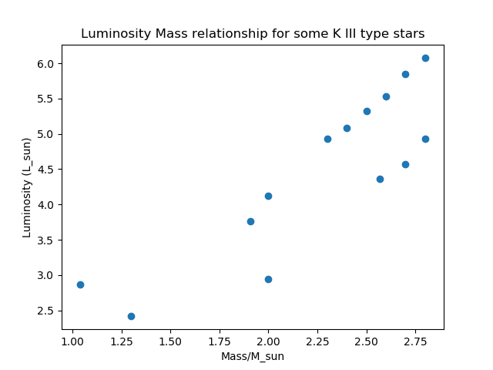
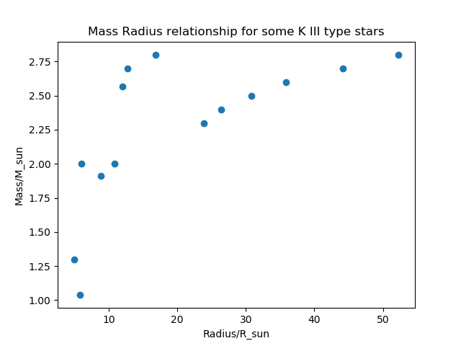
RED AND SUPER GIANTS
http://www.isthe.com/chongo/tech/astro/HR-temp-mass-table-byhrclass.html
Plotted accepted data from online sources for confirmation

Slide 6
Predictions and Assumptions
Helium burning begins around T_{c} =10⁸ K
Carbon burning begins around T_{c} = 5 x10⁸ K and ρ_{c} =3 x 10⁹ kg/m³ . Only stars over 8 Msun can reach this point
Below those conditions, we expected very low luminosities due to no energy generation.
At around those initial conditions, stars of luminosities similar to the ‘asymptotic red giant’ or the ‘supergiant’ branches were expected.

Slide 7
HOW IT WORKS
The Math Behind the Scenes

Slide 8
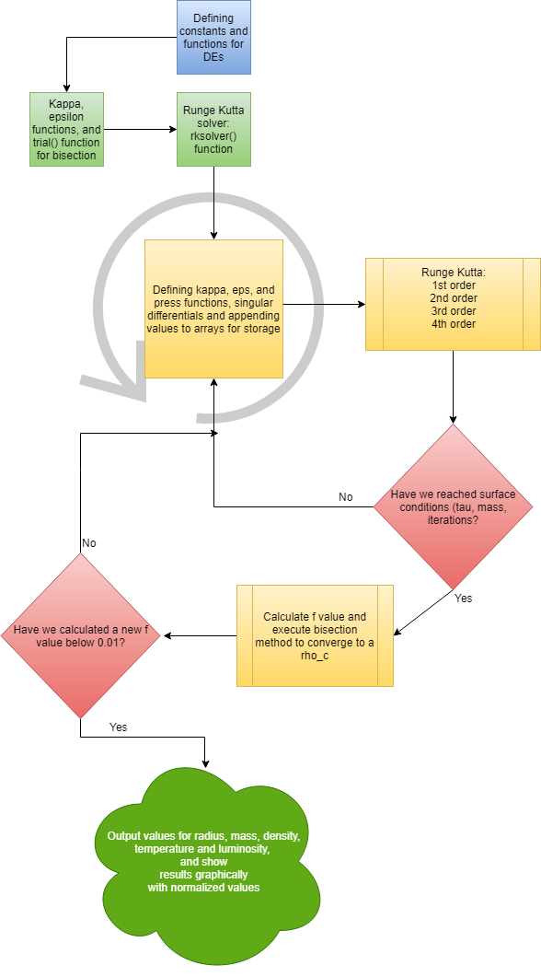
Methodology

Slide 9
GRAPHS AND ANALYSIS
Visual Results of our Main Sequence and Discrepancies Compared to Accepted Results

Slide 10
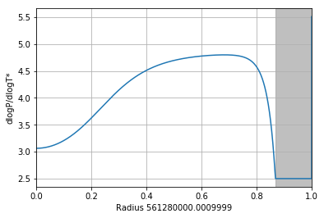
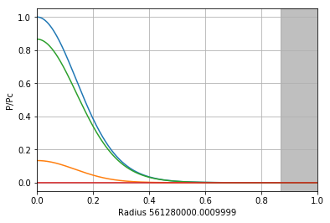
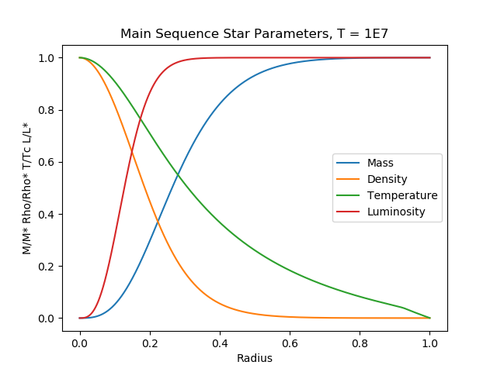
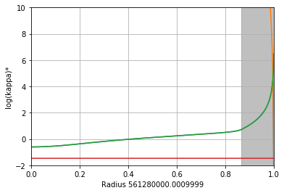
CHECKS AND BALANCES
Blue: Ptot
Green: Pgas
Orange: Pdeg
Red: Pgamma
Green: Kappa
Red: Kappa es
Notes:
Our MS plot is shown as circles, and a ‘real’ main sequence shown in triangles. As seen here, our small temperature values are a bit lower than expected, but follow the same luminosity trend as they increase toward 6000K. From there, some issues were encountered trying to converge stars at a surface. We were not able to achieve a very high precision in our delta_tau values at the surface. It is likely that, because of this, delta_tau often dropped just enough below the ⅔ mark to skew the temperatures. We had been playing with ways to inrease the precision, however, due to increased runtimes, we weren’t able to much better our results in time.
Pressure:
Blue = Ptot
Green = Pgas
Orange = PDeg
Red = Pgamma

Slide 11
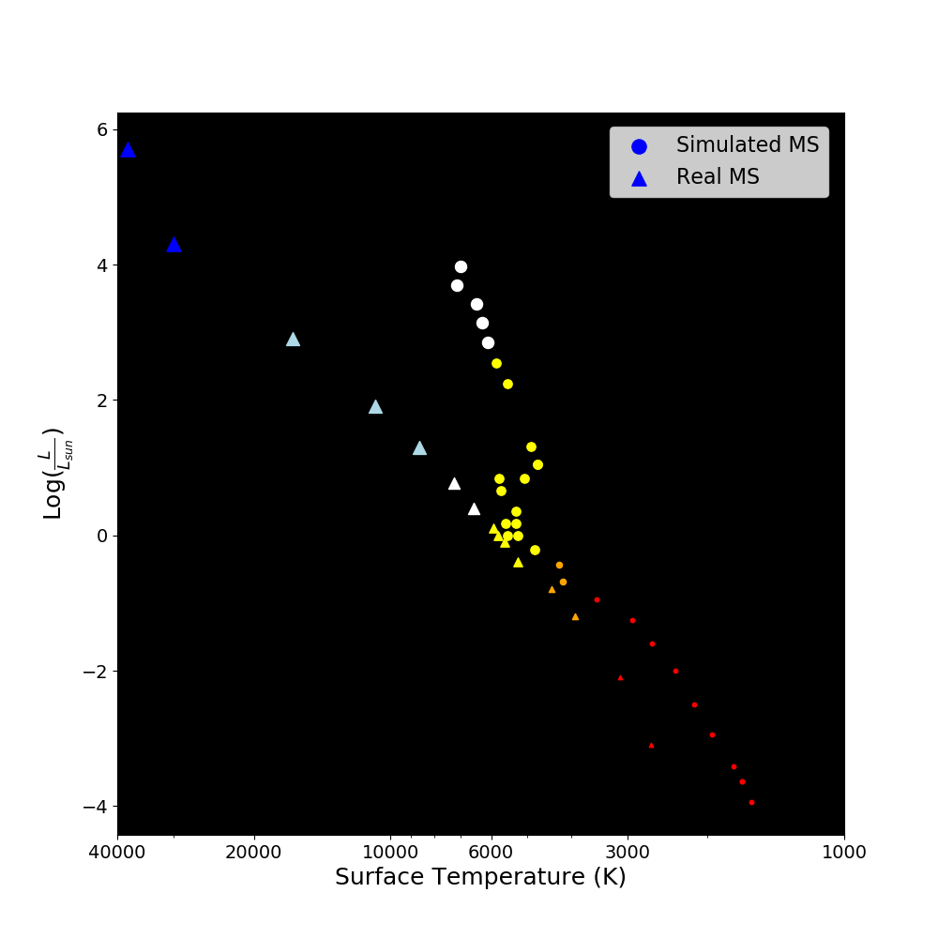
MAIN SEQUENCE
Notes:
Our MS plot is shown as circles, and a ‘real’ main sequence shown in triangles. As seen here, our small temperature values are a bit lower than expected, but follow the same luminosity trend as they increase toward 6000K. From there, some issues were encountered trying to converge stars at a surface. We were not able to achieve a very high precision in our delta_tau values at the surface. It is likely that, because of this, delta_tau often dropped just enough below the ⅔ mark to skew the temperatures. We had been playing with ways to inrease the precision, however, due to increased runtimes, we weren’t able to much better our results in time.

Slide 12
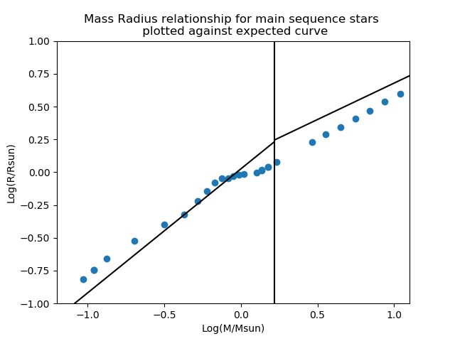
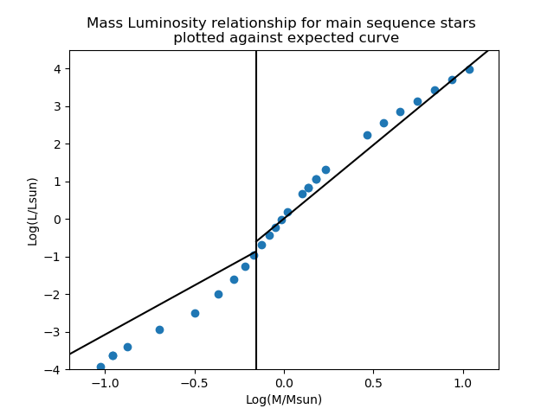
MAIN SEQUENCE
Notes:
Our MS plot is shown as circles, and a ‘real’ main sequence shown in triangles. As seen here, our small temperature values are a bit lower than expected, but follow the same luminosity trend as they increase toward 6000K. From there, some issues were encountered trying to converge stars at a surface. We were not able to achieve a very high precision in our delta_tau values at the surface. It is likely that, because of this, delta_tau often dropped just enough below the ⅔ mark to skew the temperatures. We had been playing with ways to inrease the precision, however, due to increased runtimes, we weren’t able to much better our results in time.

Slide 13
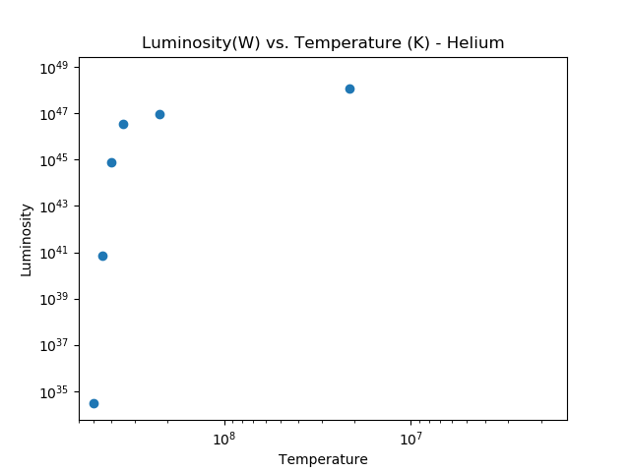
HELIUM MAIN SEQUENCE
Limitations regarding opacity value.
Numerical errors in Python due to increased sensitivity in variables
Notes:
When Helium energy generation (3alpha) was introduced, we encountered errors in the code being thrown by very large values (or very small values) in the function for kappa and other stellar structure functions (Pressure, dP/dRho). To try and mitigate these issues we explored the effects of different function terms on the overall function to determine if we could bypass certain terms that were giving us errors. This worked to an extent (just to make the code run) but did not produce meaningful results. We also attempted to increase the decimal precision of Python using the mpmath library, this allowed the code to run, but did not produce a meaningful result (this also increased run time significantly, and made the debugging process extremely difficult). Kappa was especially sensitive to temperature seeing as it depends on temperature to the 9th power. By tinkering with initial core values (still within expected values) and by patchwork of errors we were able to fully run the code and produce a result, albeit with very erroneous values. We expect much of the error to be occurring due to sensitivities in functions due to certain variables becoming extremely large, requiring more precision and fine tuning than we could achieve.
Our calculated lifetime for the He stars were between seconds and hours because of the enormous luminosity values. Accepted lifetimes are approximately 1000 years to a few billion years.

Slide 14
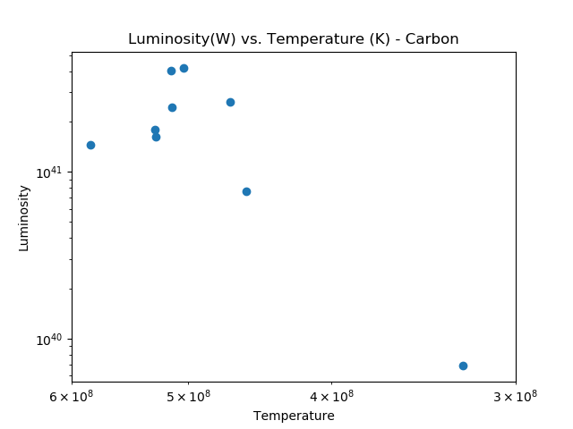
CARBON MAIN SEQUENCE
Limitations regarding opacity value.
Numerical errors in Python due to increased sensitivity in variables
Notes:
Next when we implemented the energy generation rates for carbon, we encounter the same problem as that of helium main sequence where the luminosity and surface temperatures were off the charts. The range of core temperature that the code works in is between 600-900 million kelvin, anything above or below we start numerical errors. To alleviate some of these problem we tried similar methods as before like taking out certain opacity terms or taking out terms in the stellar equations but with not much success, in the end were able to produce results but they were orders of magnitude higher than what we expected. Lifetime for carbon we got is 1s -1 hr, for actual carbon fusion that should last around 600 yrs.

Slide 15
RESULTS AND CONCLUSIONS

Slide 16
What Went Well and What Went South
Original main sequence solver gives promising results for typical stars
However, limitations with how the code handles numbers prevented us from getting meaningful results for helium and carbon core cases.
Notes:
We believe one of the main issues was that as we drove up the core temperature and core density for helium, and then carbon, it became harder and harder to properly converge star values. We already saw that it was hard to converge a core density value for a given temperature with the regular main sequence, which is the main reason our higher temp results are skewed right on that plot. Trying to bisect from high densities lead to a drastic drop in density to a negative value, which became unphysical and made some other functions unsolvable. Try to converge from low densities lead to the temperature and luminosity being far too high, as seen in our plots. It’s likely that, given more time and more capabilities to deal with precision issues, we could have been able to find converging points for some of these stars.

Slide 17
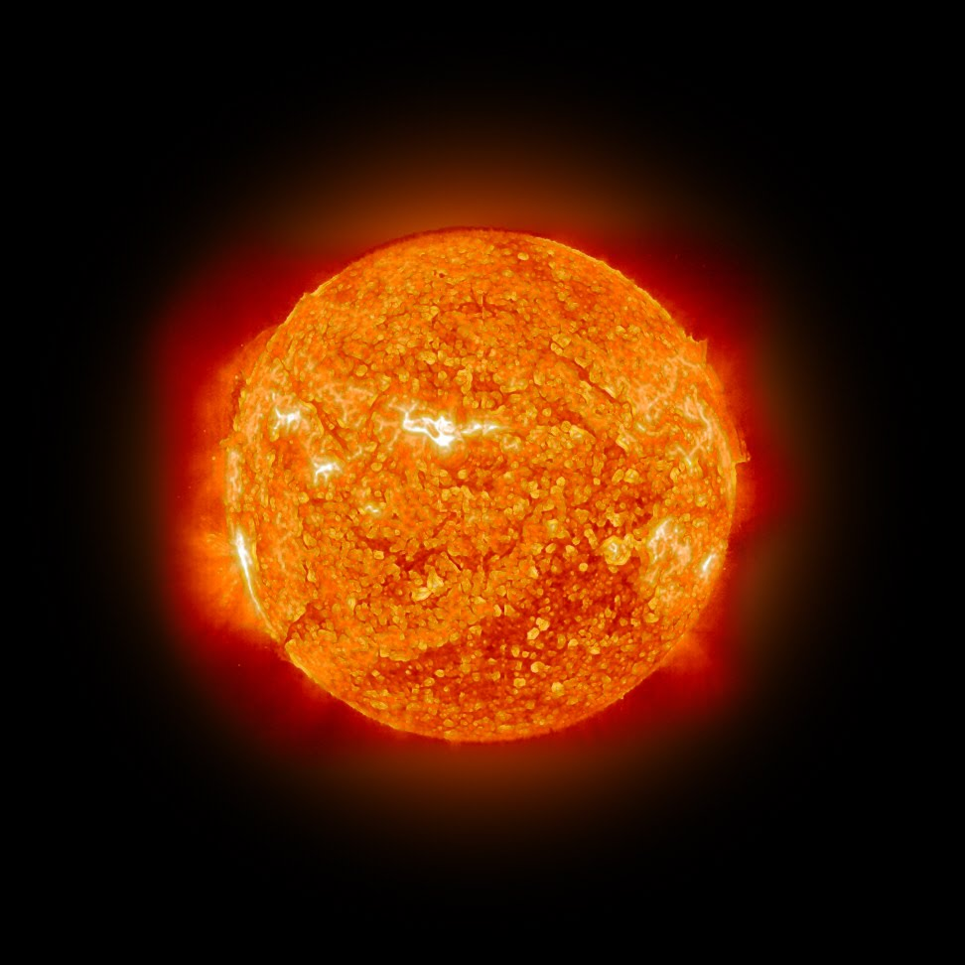
THANKS!
Any questions?

